Slide 1

Welcome everyone
.

Slide 2
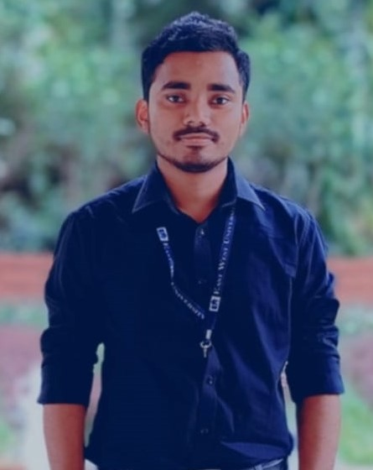
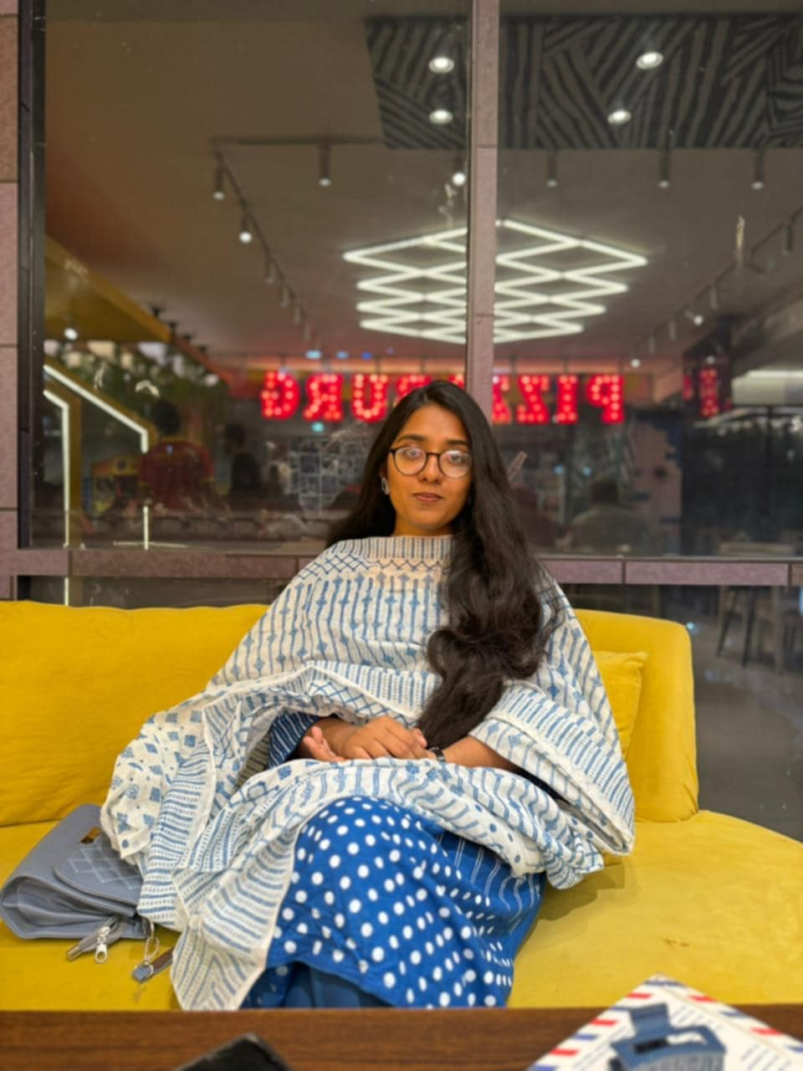
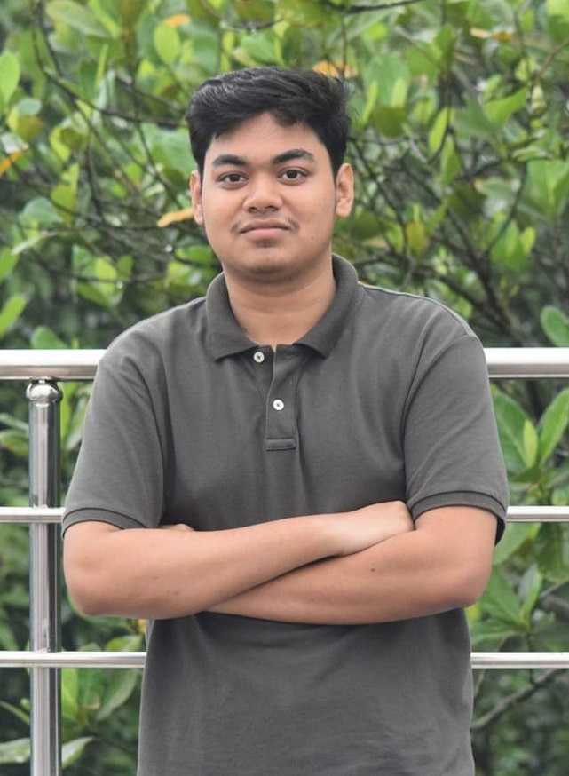
MD.Muntasir Ahmed Rifat Id: 2022-1-60-333
Team Members
Saba tasnim khan Id: 2022-3-60-049
MD. Sarafat Alam Mozumder Id: 2022-3-60-061

Slide 3
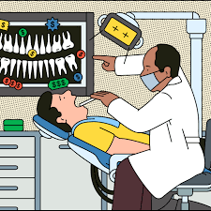
Topic
Dentist Problem

Slide 4
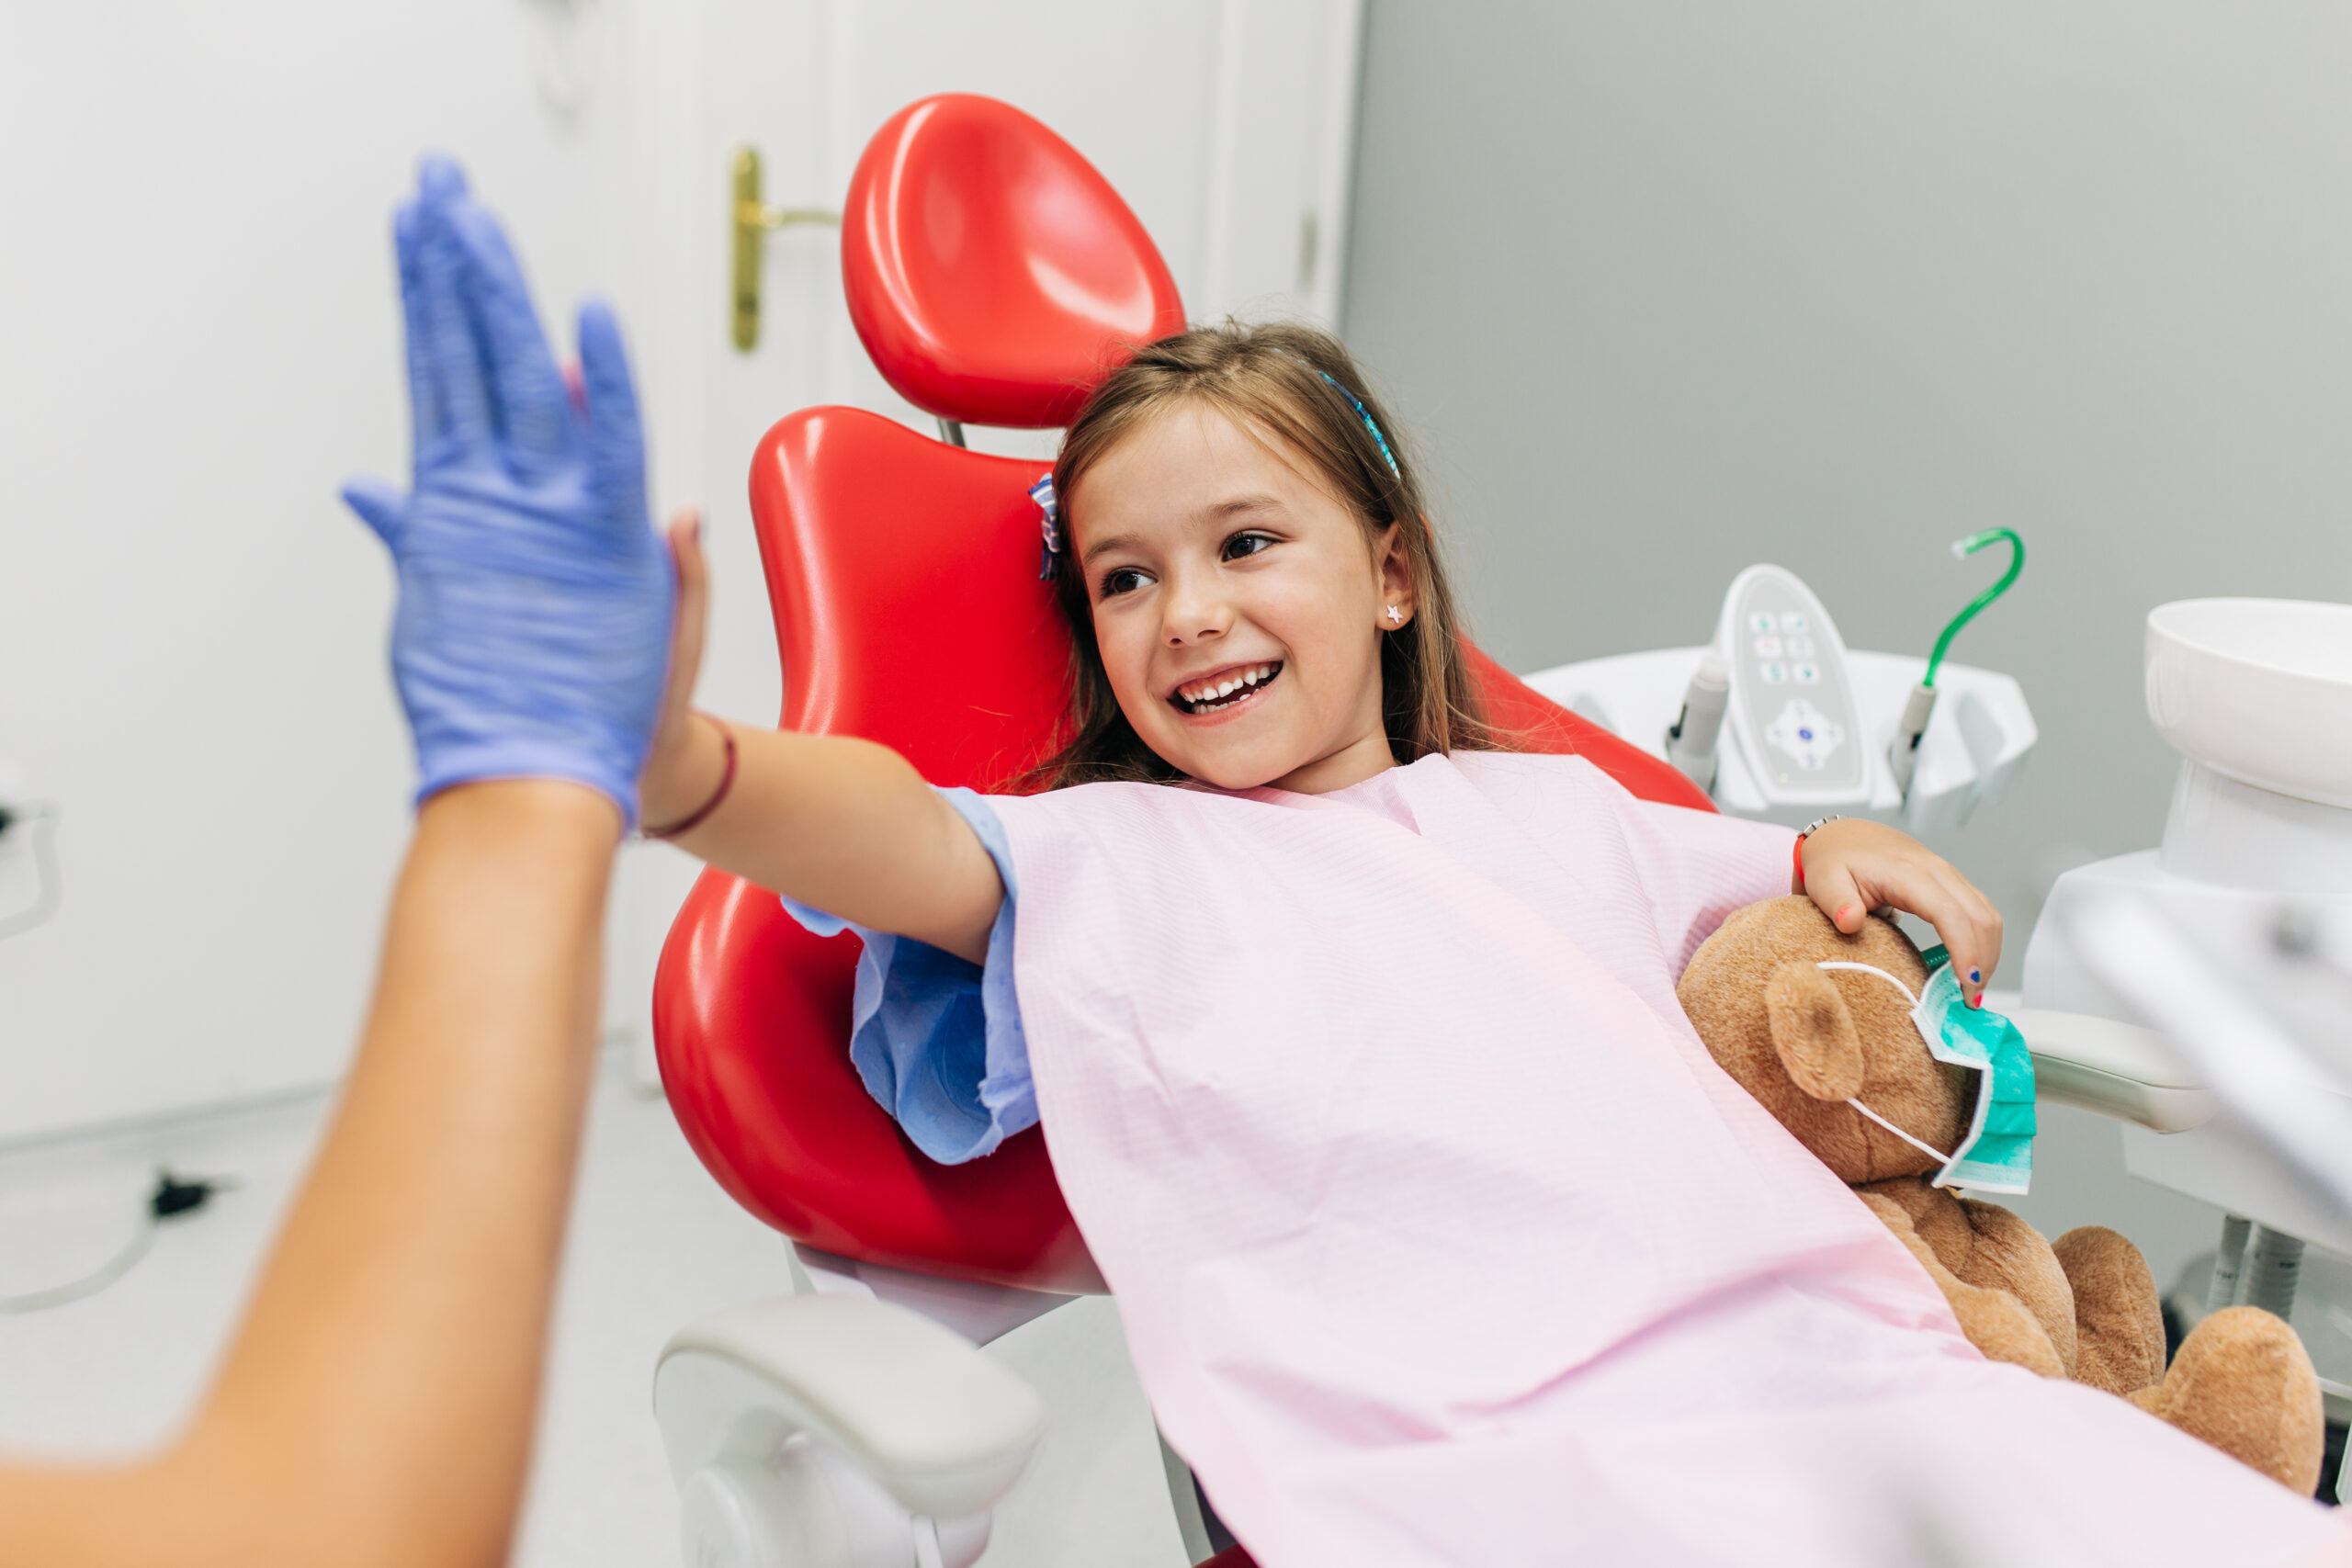
Challenges
Synchronization
Managing waiting room chairs
Ensuring leave of treated patient
Handling Appointment scheduling
Terminating Threads

Slide 5

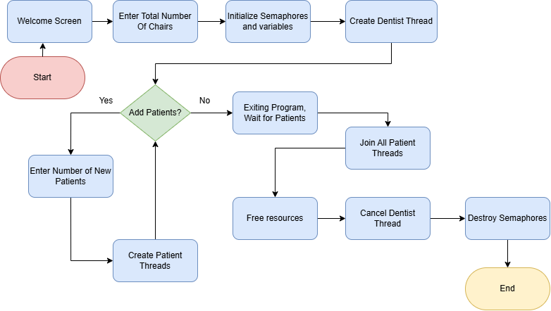

Slide 6
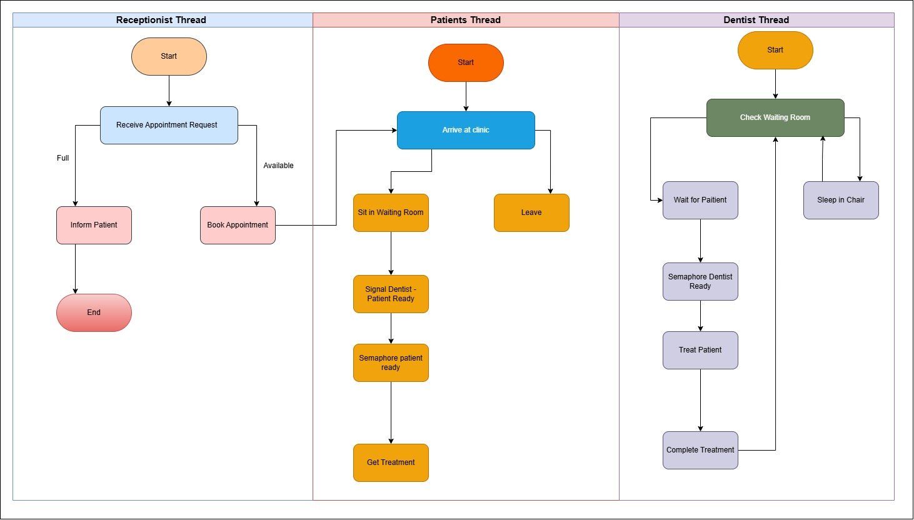

Slide 7
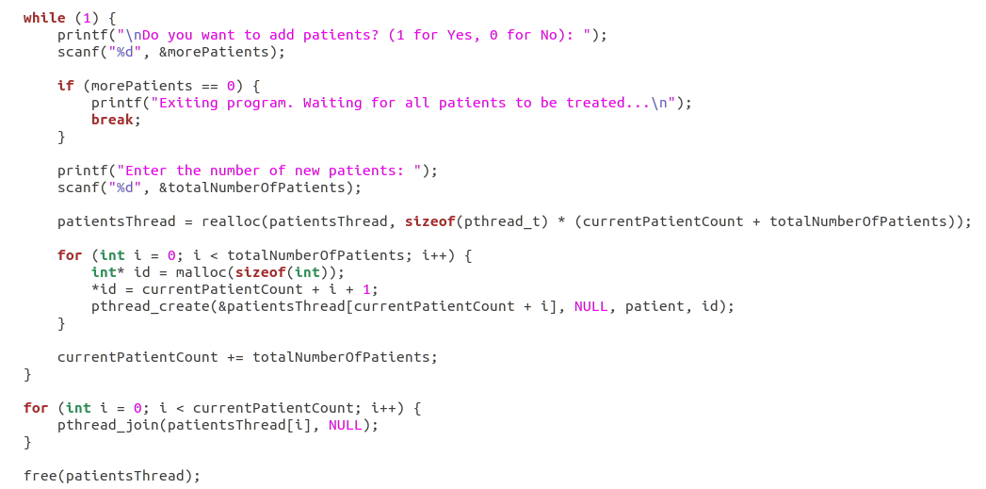
Code

Slide 8
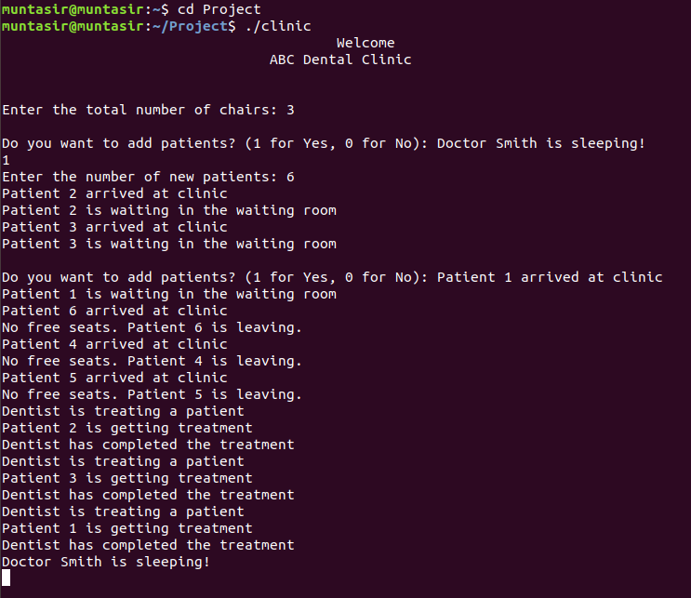
Output
of an audience’s retention rate is attributed to the visuals used

Slide 9
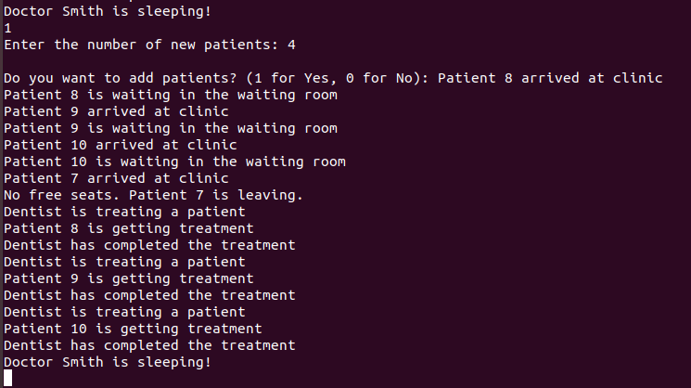
Delivering with impact
Keeping your audience engaged through effective techniques

Slide 10
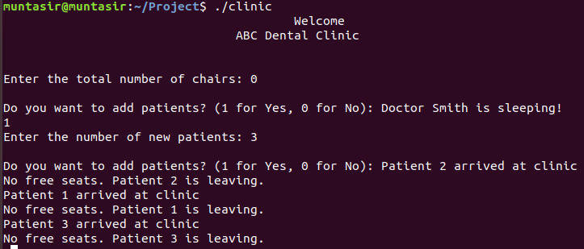
Delivering with impact
Keeping your audience engaged through effective techniques

Slide 11

Delivering with confidence

